Slide 1
Attrition Management

Slide 2
Attrition management
Our client is IBM a leading firm and is doing well in the sector. It is recently facing a steep increase in its employee attrition . Employee attrition has gone up from 14% to 25% in the last 1 year . We are asked to prepare a strategy to immediately tackle this issue such that the firm’s business is not hampered and also to propose an efficient employee satisfaction program for long run. Currently, no such program is in place . Further salary hikes are not an option.

Slide 3
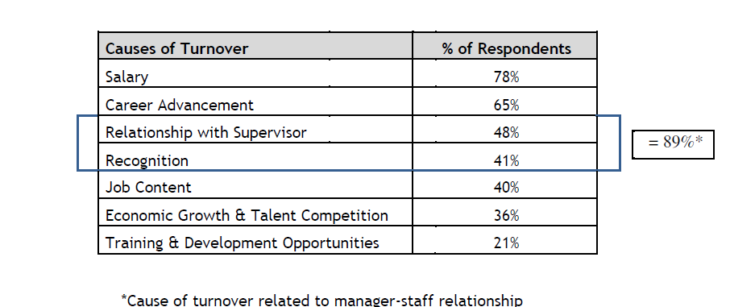
Research Inputs
Problem of attrition in IBM is not unique and several studies and research papers for the IT sector and large IT companies indicate the same.
The following studies/research papers were taken as input for framing PSW and Issue tree
*CII 2008 study

Slide 4
Problem Statement
How can we reduce IBM company's attrition rate by predicting if a candidate will exit in India within the year

Slide 5

How can we reduce IBM company's attrition rate by predicting if a candidate will exit in India within the year?
Specific :- To Indian geography in IBM
Measurable:- To reduce attrition rate(By at least 5%)
Action oriented:- Reduce employee attrition & suggest employee engagement & satisfaction programs
Relevant:- Direct impact on company's top and bottom line
Time bound :- 12 months
* The Smart framework is from Fractal analytics

Slide 6
How can we reduce IBM company's attrition rate by predicting if a candidate will exit in India within the year
1)Background | 4)Constraints
Best performing IT company in terms of topline and bottom line. Employee Attrition has increased from 14% to 25% in the last 1 year, much higher than the industry average of 16% Committed to curtailing attrition as it is not sustainable in the long run | Salary hike cannot be considered
2)Desired Outcome | 5)Stakeholders
Reduce attrition rate by 10% in the next 18 months with 2% reduction QoQ Saving recruitment cost and improving employee satisfaction rate develop a holistic employee satisfaction program | CEO/ HR Head/ BU Heads Attrition cell
3)Scope | 6)Resources
In-house attrition analysis tool and Early Warning System to identify individuals who are likely to leave and prioritize action items for immediate intervention | Interviews with HR head, Attrition cell, recruitment team, BU Heads Insights based on industry best practices and secondary research Review of exit interviews and HR attrition data to observe trends across departments, gender, experience level , etc.

